Slide 1

Research on
THE NEED FOR & impacts of Just cause Eviction policies
Molly Richard, Ph.D.
Center for Innovation in Social Science
Initiative on Cities
Boston University
richard4@bu.edu
East Providence resident
Notes:
Hello, My name is.. From…
I have been invited today to share research from my areas of expertise, homelessness and housing insecurity, and highlight emerging research on the impacts of Just Cause Eviction policies across the U.S.

Slide 2
National Trends in investor-owned rental housing
Growth in corporate & investor-owned rental housing
Higher eviction rates
More rapid rent increases & greater use of miscellaneous fees
Less responsive
Lower levels of property maintenance
Lee, 2017
Seymour et al., 2013
Raymond et al., 2018
Leung et al., 2021
Gomory, 2022
Seymour & Akers, 2021
Reosti, et al., 2023
Gurun, et al., 2023
Decker, 2023
Goetz et al., 2024
Goetz & Damiano , 2025

Slide 3
Increased housing insecurity & homelessness
Providence - the least affordable metro area in the United States (Redfin - Worley & Bokhari, 2025; based on the difference between median income required for rent and the median renter income)
In the past 5 years, homelessness in RI has doubled.
  Jan. 2024 PIT Count: 2,442 people (HUD, 2024)
The costs of not addressing this crisis are high:
  Individual –Early mortality, increased injury, exacerbated poverty, poor educational outcomes for children, negative health outcomes across the lifespan (Garcia et al., 2024; Funk et al., 2022)
  Community – High economic costs associated with homeless services, health care, criminal justice; working families feel the burden across communities (e.g., supporting doubled-up friends and family) (Keene & Blakenship, 2023)
Notes:
I believe you’ve had presentations (RIPEC) on the overall status of housing affordability and availability in the state and metro area, but I want to zero in on the bottom of that spectrum of housing unaffordability – homelessness. Too often, homelessness is discussed separately from housing, but research in social sciences, economics, and public health are increasingly drawing data-driven connections between homelessness and housing policy to inform public policy.
What does homelessness look like in the state? Since 2019, the number of people experiencing homelessness on a given night in Rhode Island has doubled, now at nearly 2500 individuals, including more than 500 people staying unsheltered, outside
At the same time, rents in the region are increasing at unprecedented rates. Just last month, analysts at Redfin named Providence the least affordable metro area in the United States (Redfin: Worley & Bokhari, 2025, based on the difference between median income required for rent and the median renter income) – beating out Miami and New York.
https://www.redfin.com/news/rent-affordability-2025/

Slide 4
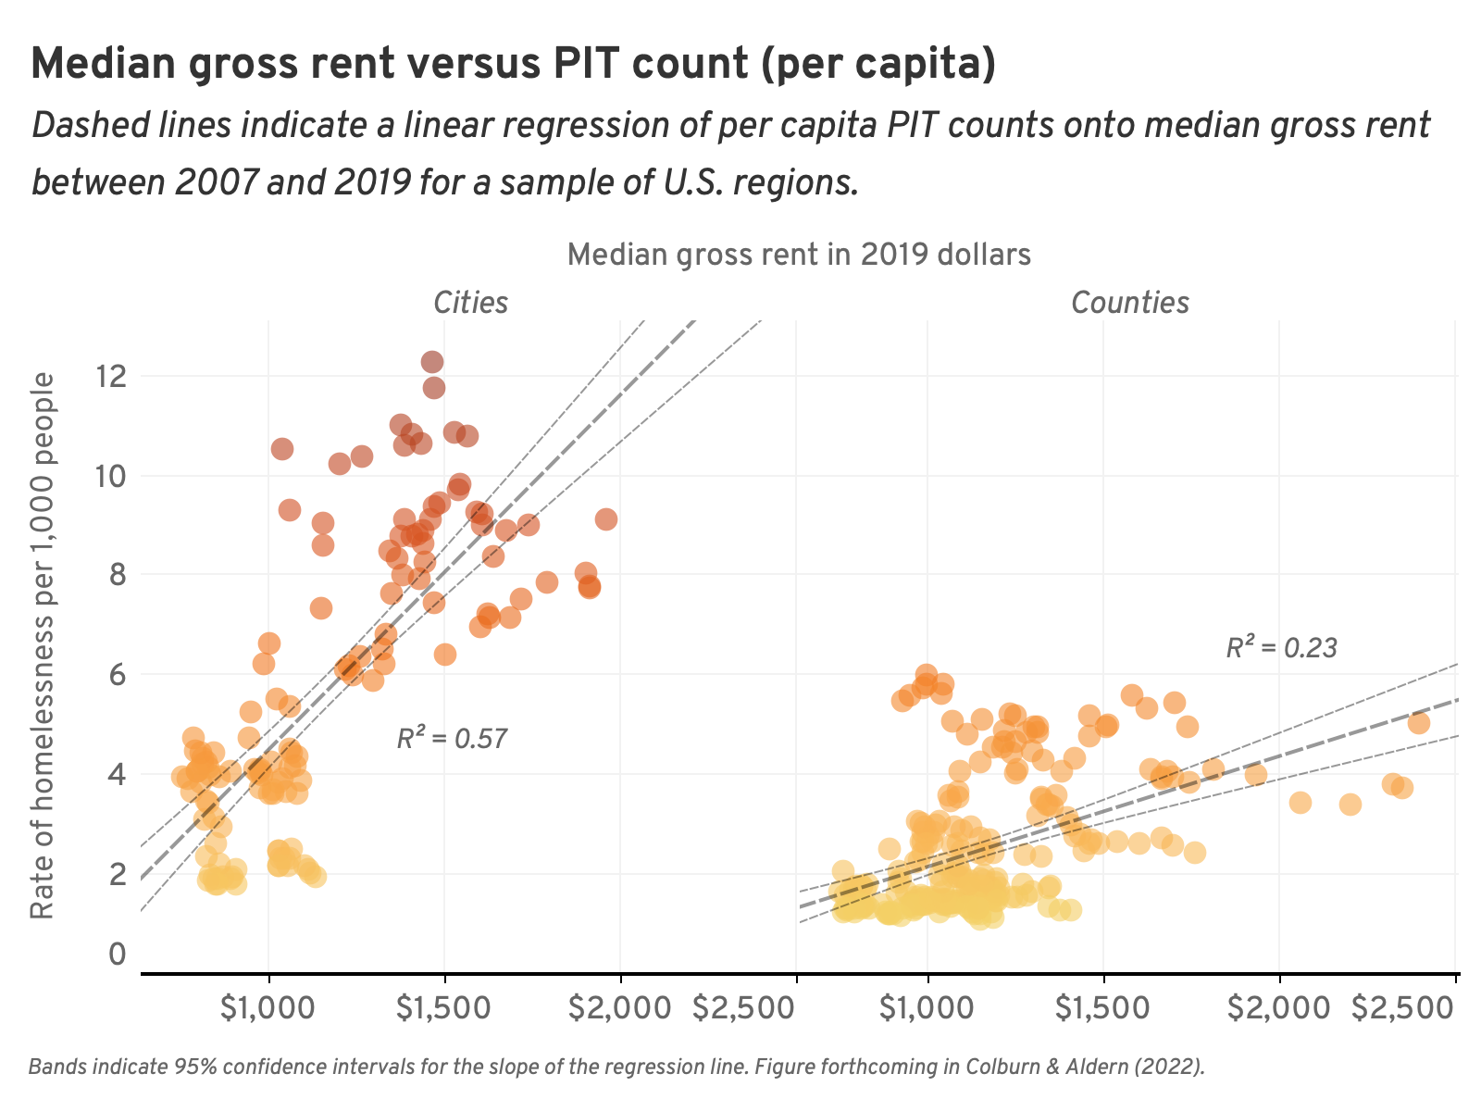
Homelessness is a housing problem
Decades of research shows a significant positive association between homelessness rates and median rent.
(Honig & Filer, 1993; Lee et al., 2003; Quigley & Raphael, 2002; Byrne et al., 2013; Fargo et al., 2013; Hanratty et al., 2017; Glynn & Fox, 2019; GAO, 2020; Colburn & Aldern, 2022; Richard, in press).
Adjusting for other factors - $100 increase in median rent is associated with:
  9% increase in total homelessness (GAO, 2020)
  27% increase in unsheltered homelessness (Richard, in press)
Figure: Colburn & Aldern 2021 book: “Homelessness is a Housing Problem”
Notes:
Gregg Colburn – a colleague of mine, associate professor of real estate at the University of Washington, along with help of data scientist, illustrates how absolute rent levels and rental vacancy rates are associated with regional rates of homelessness. Many other common explanations—drug use, mental illness, poverty, or local political context—fail to account for regional variation
This book lays out the research powerfully for a policy audience, yet decades of research has found the same thing).
I share this to set the stage for the research on

Slide 5
How can we improve housing stability?
In addition to preserving and producing affordable housing, communities can improve housing stability through renter protections (Merrit & Farnworth, 2021).
Just Cause Eviction Protections help renters stay in their homes by preventing arbitrary, unfair, or retaliatory evictions.

Slide 6
Widespread adoption of Just cause
Dozens of municipalities operate Just/Good cause along with other tenant protections such as rent stabilization.
NJ, OR, CA, NH, WA state-level legislation
Municipalities in NY and scattered across the country, including Philadelphia, St. Paul, and Washington DC
(National Low Income Housing Coalition Tenant Protections Database, 2025)
Notes:
I don’t need to define just cause…

Slide 7
Impact of JUST cause Eviction protections
Meets stated goals:
  Leads to decrease in eviction filings (Cuellar, 2019: Rate of Evictions before & after Good Cause Law Passed in California Cities)
  Is associated with lower rates of outmigration (Hwang et al., 2022)
  Has a direct and immediate impact on mitigating displacement (Chapple et al., 2023)
Some argue that these protections discourage new housing construction.
  However, there is no published research to support this claim. In fact, evidence suggests otherwise.
Notes:
Cuellar, Julieta. "Effect of “just cause” eviction ordinances on eviction in four California cities." Journal of Public & International Affairs 30 (2019).
Hwang, Jackelyn, Iris Zhang, Jae Sik Jeon, Karen Chapple, Julia Greenberg, and Bina Shrimali. “Who Benefits from Tenant Protections? The Effects of Rent Stabilization and Just Cause for Evictions on Residential Mobility in the Bay Area.” UC Berkley

Slide 8
Impact of JUST cause Eviction protections
A closer look at a working study of CA, OR, and NH (CA & OR enacted good cause in 2019; NH enacted in 2015)
Pre- and post enactment of Just Cause
In the absence of experimental design - “Difference in differences” model
  Comparison to similar jurisdictions without good cause
  A comparison of trends
Data and analysis:
  County-level data on housing production
    Housing permit data (HUD)
  Controlling for income per capita, population, county-level GDP, unemployment, housing vacancy rate
  University of Minnesota Center for Urban and Regional Affairs & Loyola University Maryland Department of Economics: Shwartz, Goetz, Card & Davis, 2025
Notes:
The research scientists at University of Minnesota and Loyola University Maryland has conducted the first, that we know of, analysis of the impact of Good Cause Eviction Protections on development. The analysis finds no evidence that the introduction of Good Cause Eviction Protections in California, Oregon, and New Hampshire resulted in a decline of new construction
We test this with a more rigorous statistical method known as a “difference-in-differences” model. This approach tests whether the trends in permitting among counties subject to the passage of the legislation were different from the trends in nearby counties not subject to the legislation, after controlling for other factors including county level GDP, population, unemployment and per capita income.

Slide 9
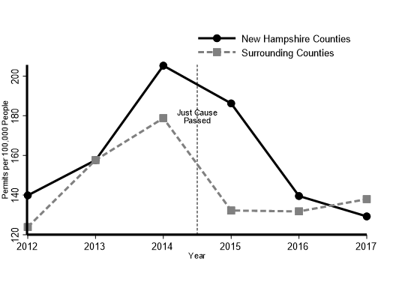
Impact of JUST cause Eviction protections
New Hampshire: Housing permits did not decline relative to the county-level trends in neighboring states that do not have just cause eviction protections
  (University of Minnesota and Loyola University Maryland, 2025 working paper - Shwartz, Goetz, Card & Davis)
Notes:
New Hampshire passed Good Cause legislation in 2015. Figure 2 plots average permits per 100,000 people for New Hampshire counties and counties in the surrounding states of Maine, Massachusetts and Vermont. Prior to the passage of Good Cause, permits were increasing in the counties of New Hampshire and surrounding states. In 2015, permits fell in both New Hampshire and its surrounding states. The difference-in-difference model indicates that the rate of change in New Hampshire was not statistically different from the change in surrounding states.

Slide 10
Impact of JUST cause Eviction protections
CA and OR: Housing permits did not decline relative to the county-level trends in neighboring, matched counties in states that do not have just cause eviction protections
  Permitting in CA & OR actually increased relative to comparison counties, though not statistically significant
  (University of Minnesota and Loyola University Maryland, 2025 working paper - Shwartz, Goetz, Card & Davis)
Notes:
Later data (passed in 2019)
We find that permits did not decline in California and Oregon counties relative to the changes occurring in surrounding states. In fact, the data show an increase in permits by 41 per 100,000 residents after the legislation passed relative to the comparison counties, though this result was not statistically significant.
(Washington, Nevada, Idaho and Arizona. )
Like NH findings, this again suggests that there is no evidence that Good- or Just- Cause legislation leads to lower rates of development where it is enacted.

Slide 11
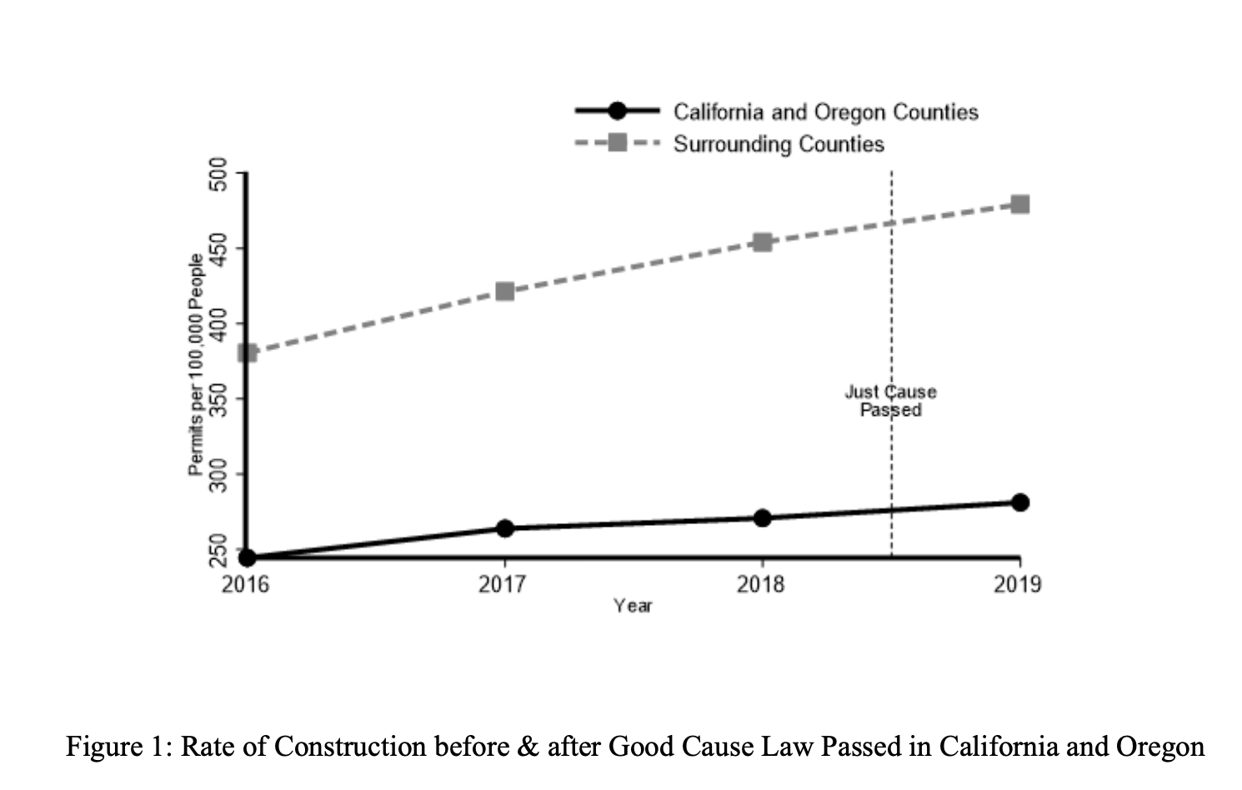
  (University of Minnesota and Loyola University Maryland, 2025 working paper - Shwartz, Goetz, Card & Davis)

Slide 12
Impact of JUST cause Eviction protections
In both analyses - no evidence that passage of Just Cause legislation at the state level led to a decline in housing production.
The authors have gathered 54 endorsing academic peer signatories on letter reporting the emerging research and in support of the potential of Just Cause eviction legislation (including Harvard, Boston University, Rutgers, MIT, Tufts, UCLA)
  (University of Minnesota and Loyola University Maryland, 2025 working paper - Shwartz, Goetz, Card & Davis)
Notes:
Since it is a working paper not yet published in a peer reviewed article, the authors have worked to bolster the legitmicy and disseminate the findings by sharing with colleagues and getting signatories – so that the work can be immediately useful to policymakers across Maryland, Connecticut, and here in RI considering this type of policy change.
Research is ongoing on a variety of channels including exploring Good Cause’s impact on types of permits (i.e. multi-family versus single family), evaluating the impact of other states’ passage of Good Cause legislation, examining data at the municipal level, and including additional controls to the statistical model.

Slide 13
Conclusion
Long-standing research shows that intervening in the housing market is necessary to address homelessness and housing insecurity.
  And is therefore key to preventing the individual, family, and community costs of these issues.
Emerging research shows Just Cause protections can produce their intended effects
  Reducing evictions
  Stabilizing households in their apartments and neighborhoods
  …Without leading to reduced rates of housing production.
Notes:
(e.g., health disparities, ballooning costs of emergency services)
My goal – share the emerging research of my colleagues and underscore the importance of this work to addressing the homelessness crisis, an area of my own research, and a priority that is too often disconnected from our conversations about housing)

Slide 14
References
Byrne, T., Munley, E. A., Fargo, J. D., Montgomery, A. E., & Culhane, D. P. (2013). New perspectives on community-level determinants of homelessness. Journal of Urban Affairs, 35(5), 607–625.
Chapple, K., Loukaitou-Sideris, A., Miller, A., & Zeger, C. (2023). The role of local housing policies in preventing displacement: A literature review. Journal of Planning Literature, 38(2), 200-214..
Colburn, G., & Aldern, C. P. (2022). Homelessness is a housing problem. University of California Press.
Cuéllar, J. (2019). Effect of “just cause” eviction ordinances on eviction in four California cities. Journal of Public & International Affairs, 30, 4.
Funk, A. M., Greene, R. N., Dill, K., & Valvassori, P. (2022). The impact of homelessness on mortality of individuals living in the United States: A systematic review of the literature. Journal of Health Care for the Poor and Underserved, 33(1), 457-477.
Garcia, C., Doran, K., & Kushel, M. (2024). Homelessness and health: Factors, evidence, innovations that work, and policy recommendations: An overview of factors and policy recommendations pertaining to homelessness and health. Health Affairs, 43(2), 164-171.
Hanratty, M. (2017). Do local economic conditions affect homelessness? Impact of area housing market factors, unemployment, and poverty on community homeless rates. Housing Policy Debate, 27(4), 640-655.
Honig, M., & Filer, R. K. (1993). Causes of intercity variation in homelessness. The American Economic Review, 83(1), 248–255.
Hwang, J., Zhang, I., Jeon, J. S., Chapple, K., Greenberg, J., & Shrimali, B. 2022. “Research Brief: Who Benefits from Tenant Protections? The Effects of Rent Stabilization and Just Cause for Evictions on Residential Mobility in the Bay Area.” https://static1.squarespace.com/static/5ebc6a5493ebe43c8bd9518e/t/622ff5be4c6e1e75933f7945/1647310272596/Brief_Who+Benefits+From+Tenant+Protections.pdf
Keene, D. E., & Blankenship, K. M. (2023). The Affordable Rental Housing Crisis and Population Health Equity: A Multidimensional and Multilevel Framework. Journal of Urban Health, 100(6), 1212–1223.
Lee, B. A., Price-Spratlen, T., & Kanan, J. W. (2003). Determinants of homelessness in metropolitan areas. Journal of Urban Affairs, 25(3), 335–356.
Merritt, B., & Farnworth, M. D. (2020). State Landlord–Tenant Policy and Eviction Rates in Majority-Minority Neighborhoods. Housing Policy Debate, 31(3–5), 562–581
National Low Income Housing Coalition. (Updated 2025). State and Local Tenant Protections Database. https://nlihc.org/tenant-protections
National U.S. Dept of Housing and Urban Development. (2024, Dec). HUD 2024 Continuum of Care Homeless Assistance Programs Homeless Populations and Subpopulations. https://files.hudexchange.info/reports/published/CoC_PopSub_CoC_RI-500-2024_RI_2024.pd
Quigley, J. M., & Raphael, S. (2002). The Economics of Homelessness: The evidence from North America. European Journal of Housing Policy, 1(3), 323–336.
Richard, M. K. (In press). Homelessness and race: The impact of structural conditions on Back, White, and Latine homelessness. Accepted for publication in Social Problems
Shwartz, J., Goetz, E., Card, K., Davis, E. (2025 working paper) University of Minnesota Center for Urban and Regional Affairs, Loyaola University Maryland.
Worley, M. & Bokhari, S. Renters Need to Earn $63,680 to Afford the Typical U.S. Apartment—the Lowest Amount in 3 Years. Redfin News. https://www.redfin.com/news/rent-affordability-2025/
Notes:
https://rentersunitedmaryland.org/researchers-find-good-cause-eviction-legislation-keeps-families-in-homes-without-reducing-housing-supply/

